Slide 1
MCB 638
Live Session 3
Monday

Slide 2
Agenda for Live Session 3
Process Learnings
Quiz 1 Results
Project
4. Distributions
Hypothesis Testing
6. Wrap-up/What’s next

Slide 3
Process Learnings
Be sure to reference our Syllabus posted under Files for our class due dates, location of quizzes and HW, etc.
If issues with 2SU, try another browser first. Then call Student Support.
If issues with LaunchPad, make sure Flash is enabled, and try another browser first, then call LaunchPad Technical Support at 800-936-6899. Please do this before the HW is due.
Reminder of 10%-point deduction for every day late on HW, Quizzes, Final, Project up to 4 days late. 0 credit after that.
Be sure not to make your continuous data discrete by rounding.

Slide 4
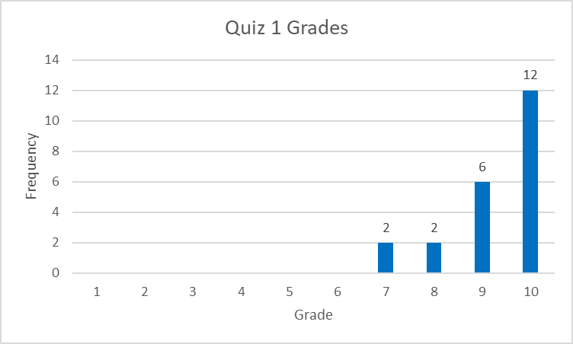
Quiz 1 Results - Histogram
Measures of Central Tendency:
Mean: 9.3
Median: 10
Mode: 10
Note: Equal sized bins

Slide 5
Projects – Next Steps
Make any updates to Problem Definition worksheet based on feedback. No need to re-submit. This may be useful for you when you complete your final project PowerPoint.
Create Data Measurement Plan or Data Stratification Tree
Start to gather data as listed on your Data Measurement Plan or Data Stratification Tree.

Slide 6
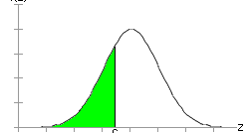
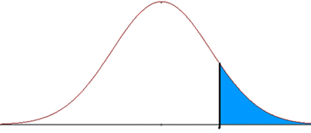
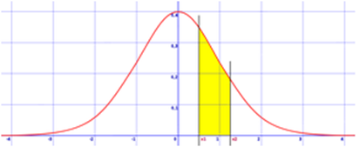
Distributions – Normal Distribution
Continuous: Normal distribution
About probability
Use table or Excel
Normal: Z = (x-mu)
std dev
Then look up Z in Table C for Probability of what falls to left of Z
If you want the probability greater than Z,
You need to subtract the probability the Z table
gives you from 1
If you need the probability that the data falls between 2 points,
find the probability for each point and subtract them
The probability the Z table gives you
is the area to the left of Z

Slide 7
Normal Distribution – Table C Note – in “Tables B-C-D plus” in our Files
Example 1: Standard Normal Table
Z 0.00 0.01 0.02 0.03 0.04 0.05 …
⋮ ⋮ …
1.5 0.9332 0.9345 0.9357 0.9370 0.9382 0.9394
1.6 0.9452 0.9463 0.9474 0.9484 0.9495 0.9505
1.7 0.9554 0.9564 0.9573 0.9582 0.9591 0.9599
1.8 0.9641 0.9649 0.9656 0.9664 0.9671 0.9678
1.9 0.9713 0.9719 0.9726 0.9732 0.9738 0.9744
2.0 0.9772 0.9778 0.9783 0.9788 0.9793 0.9798
2.1 0.9821 0.9826 0.9830 0.9834 0.9838 0.9842
2.2 0.9861 0.9864 0.9868 0.9871 0.9875 0.9878
2.3 0.9893 0.9896 0.9898 0.9901 0.9904 0.9906
2.4 0.9918 0.9920 0.9922 0.9925 0.9927 0.9929

Slide 8
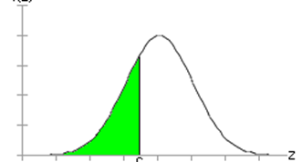
Normal Distribution – Example – SAT scores
The average SAT score is 514
The standard deviation is 118
What is the proportion of SAT scores below 396?
Formula: Z= (x- mu)
Std Dev
Z= (396-514)/118
Z= -1
From the table, proportion of SAT scores below 396 = .1587 = 15.87%

Slide 9
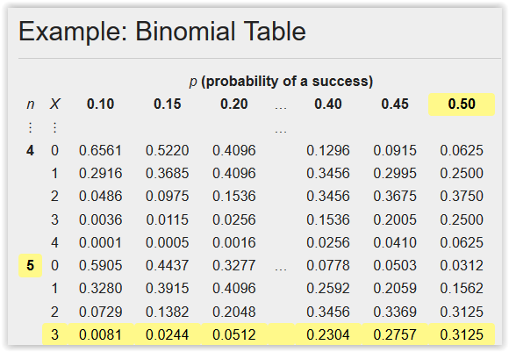
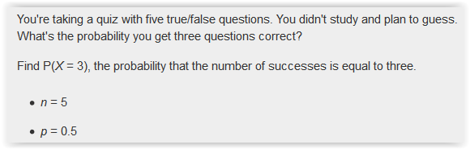
Distributions – Binomial Distribution
Discrete: Binomial distribution (Y/N, Good/Bad)
About probability
Use table or Excel
Binomial - can calculate the Probability of success of getting x number of items good or yes or correct out of n by using Binomial Table.
Example:
Probability = 31.25%

Slide 10
Excel formulas
Normal distributions: Z = x – mu
std dev
To get probability under the curve: Norm.dist (x, mean, std dev, cumulative (True or False))
If you have Z and want the probability: Norm.s.dist (Z, cumulative (True or False))
If you need to go backwards to get a Z value: Norm.s.inv (Probability)
True means we want the probability of ALL the data to the left of x
False means we want the probability of exactly x

Slide 11
Excel formulas
Binomial distribution (Good/bad, True/False, Pass/Fail)
Binom.dist (number_s, trials, prob_s, cumulative)
# of successes, n, probability of success, True or False
True means we want the probability of ALL the data to the left of x
False means we want the probability of exactly x
Gives you a probability value

Slide 12
Hypothesis Testing
Key points:
Ho (the null hypotheses) and Ha (the alternative hypothesis)
Ho - always includes =. Could be >=,<=
Ho – there is no difference
Ha – always put what you are looking to prove here – There is a difference
Do you have continuous or discrete data?
Do you have a one sample or two sample test?
If p is low, Ho must go
If p < alpha, reject the null

Slide 13
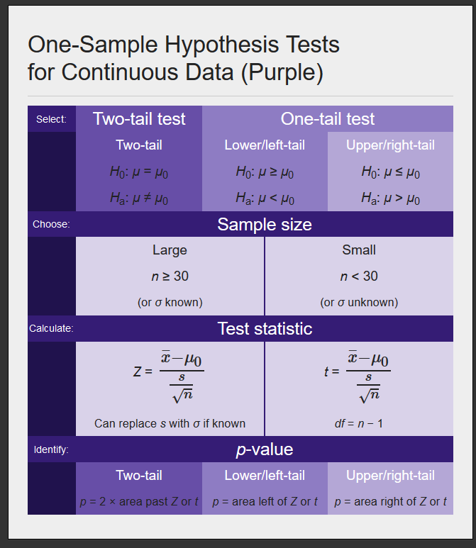
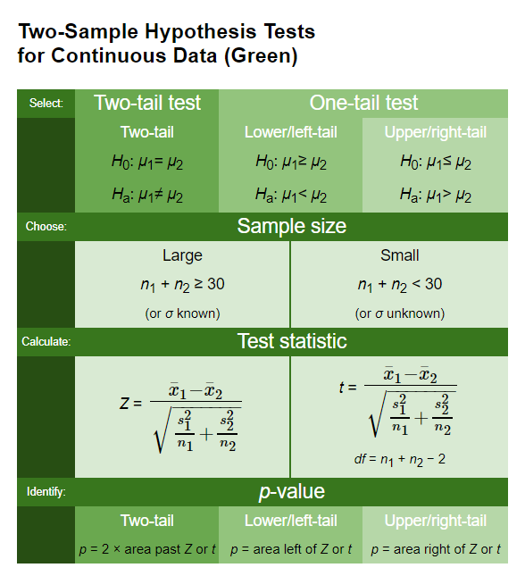
Hypothesis Tests for Continuous Data

Slide 14
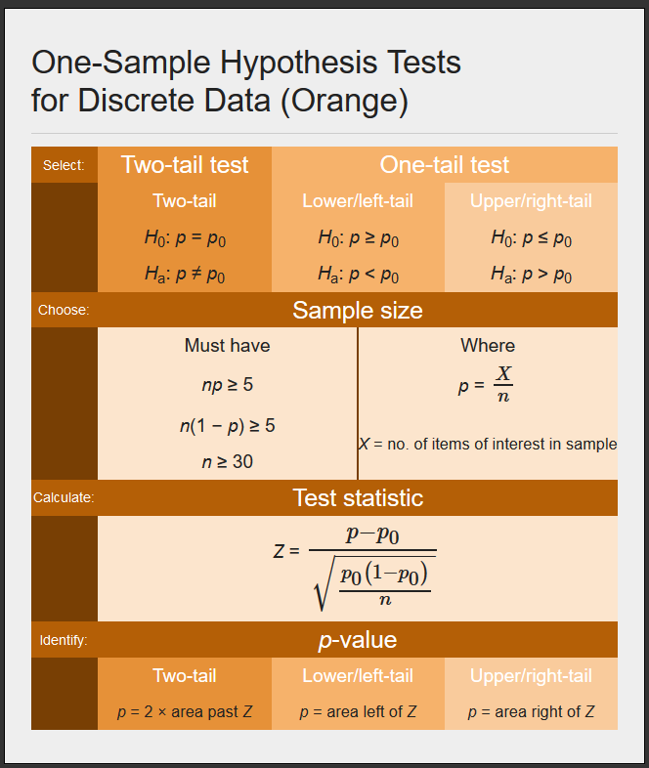
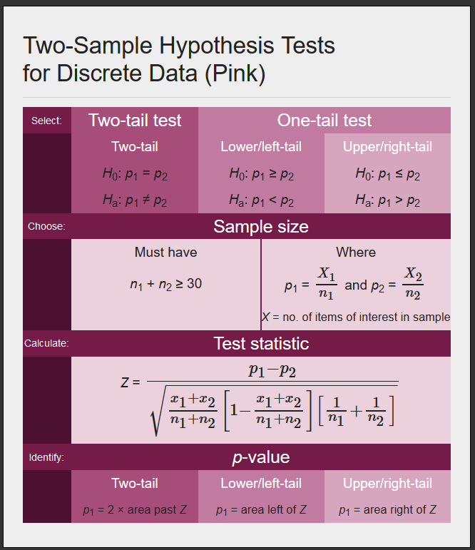
Hypothesis Tests for Discrete Data

Slide 15
Hypothesis Testing
Develop your hypothesis statements H₀ and H_{a}.
These are statements about a population, so they are written in terms of a population parameter.
The null hypothesis, H₀, is a statement of "no effect" or "no difference." It cannot be proven true but can be shown to be untrue with specific risks of error. These decisions are analogous to a courtroom finding a defendant not guilty or guilty
The alternative hypothesis, H_{a}, represents the result when the null hypothesis is rejected. Because H_{a} expresses the hypothesis we hope to find evidence for, begin with H_{a} and set up H₀ as the nonoccurrence of the "preferred" outcome.
Select a level of significance α.
Confidence level is 1 − α.
Select a sample size n.
Select an appropriate test (one sample, two sided, etc.) for your hypothesis.
Calculate the standardized test statistic from the sample data (t, Z, etc.).
Use the test statistic to compute the area in the tail(s), or p-value.
Compare the p-value with α.
Reject or fail to reject the null hypothesis.
State your decision.

Slide 16
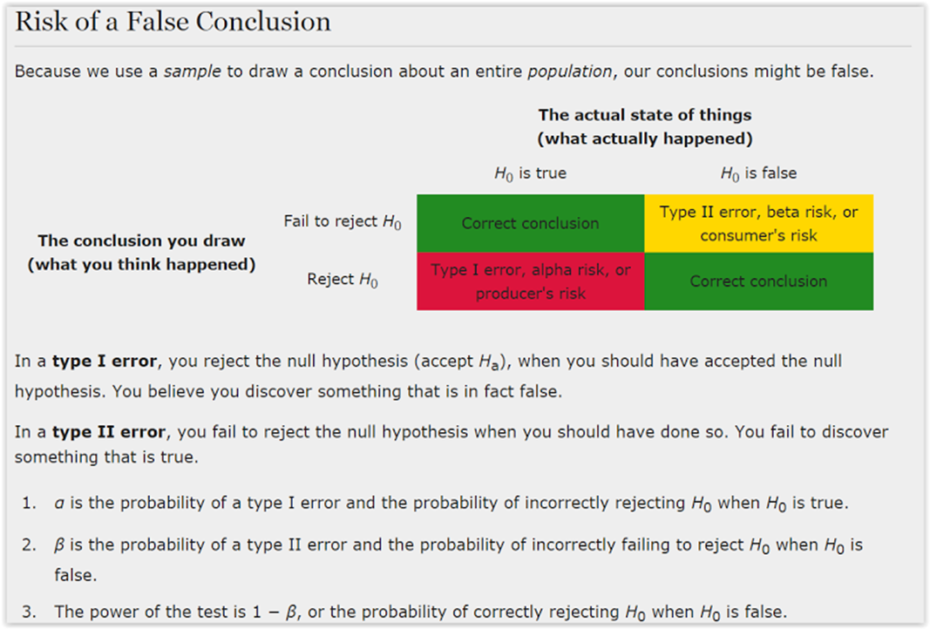
Error

Slide 17
What’s next:
Class Assignments | Submit / Post Location | Due / Date
Week 3 (Reference: textbook Ch.6 - skip sect. 6.3, Ch.7 - sect. 7.1 only)
Homework #1: (worth 5 points) LaunchPad Assignments Complete LearningCurve for Chapter 3. Complete StatTutor (3 topics): Chapter 6 – Normal Distributions - The Standard Normal Distribution - Using the Standard Normal Table | LaunchPad | 3 days after Live Session 3 = Oct 22
Week 4 (Reference: textbook Ch.9 – skip sect.9.2 & 9.6, Ch.11 – sect. 11.2 only)
Homework #2: (worth 3 points) LaunchPad Assignments Chapter 9 Practice Quiz (unlimited attempts) Complete StatTutor: Chapter 11 – Expected counts in 2-way tables | LaunchPad | 3 days after Live Session 4 = Oct 29
Project – Check your timeline and be sure you are on track
- Make any updates to Problem Definition worksheet based on feedback
- Data Measurement Plan or Data Stratification Tree and begin to gather data

Slide 18
Questions?

